Slide 1
LED array acquisition in Road to Vehicle Visible Light Communication when receiver crosses transmitter
2021/12/02 ICETC 2021
Nagoya University Kento Nakamura
Takaya Yamazato, Masayuki, Koji Kamakura,
Shintaro Arai, Tomohiro, Toshiaki Fujii

Slide 2
Contents
Reaserch background
System model of VLC and Algorithm for LED acquisition
Result of Experiment
Conclusion

Slide 3
Contents
Reaserch background
System model of VLC and Algorithm for LED acquisition
Result of Experiment
Conclusion

Slide 4
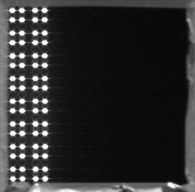

Vehicle-to-Vehicle and Roadside Communications
Research on Vehicle-to-Vehicle and Roadside Communications
Used driving support systems and Intelligent Transport Systems.
Visible Light Communication
Communication using LEDs as a transmitter and a camera as a receiver
On the road, this system can use traffic lights and vehicle lights as a transmitter and onboard cameras as a receiver.
⇒Intelligent Transport Systems using Visible Light Communication is called ITS-VLC
1
0
0
1

Slide 5
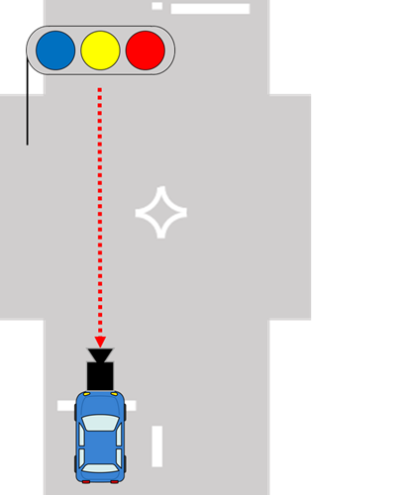

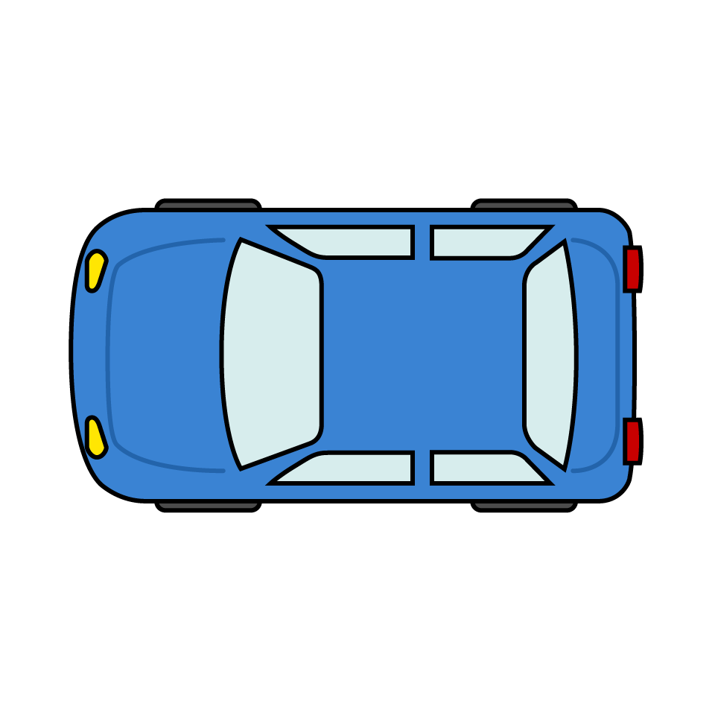
Research Trend of ITS-VLC
Most of the models have the transmitter in front of the receiver.^{[1]} There are few models where the receiver crosses the transmitter.
→ In this study, I proposed a communication model where the receiver crosses the transmitter.
①conventional model
② Proposed model
[1] S. Arai, T. Yamazato, H. Okada, T. Fujii, T. Yendo, “LED acquisition methods for image-sensor-based visible light communication”, IEEE Opto-Electronics and Communications Conference (OECC). pp. 1-3, 2015

Slide 6

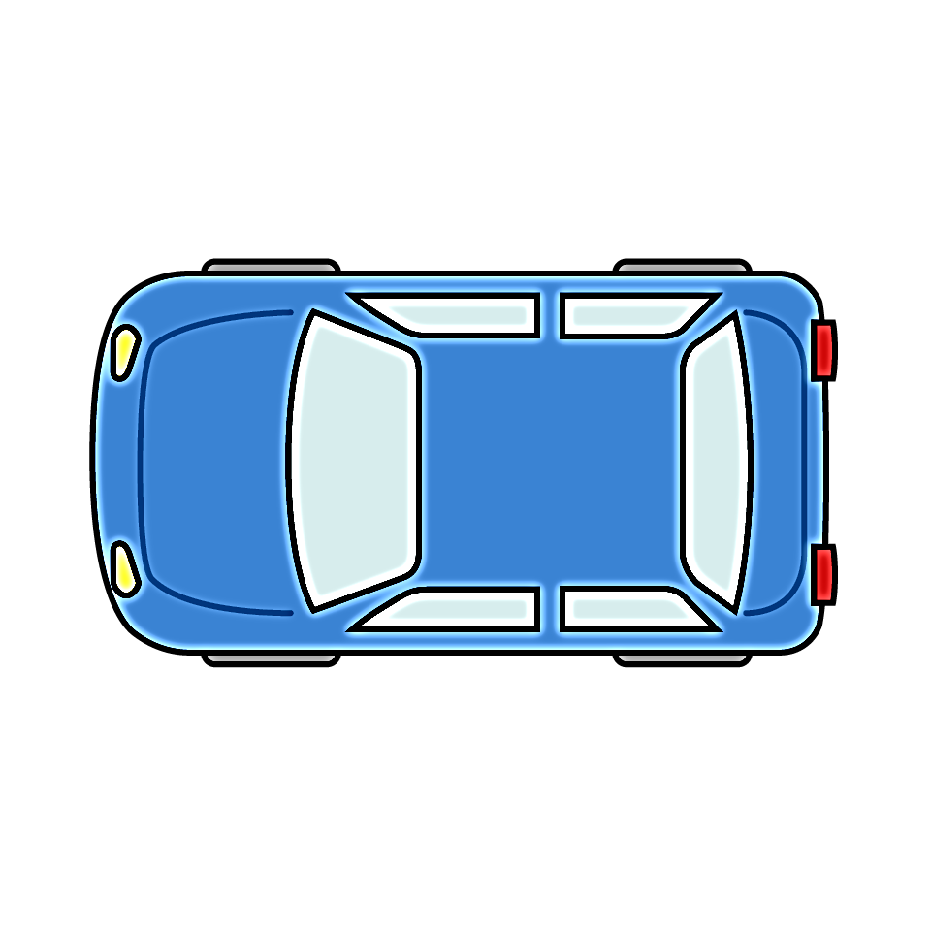
Problem of my Research
The feature of my research is that the receiver crosses the transmitter
Previous studies have not assumed that the transmitter moves in the captured image
Shooting time is short, and the number of captured images is very small
I have to perform LED acquisition and data demodulation from a small number of images in a short time
transmitter
Captured
images
Notes:
画像は，horizontal signal 1の 372,373,374

Slide 7
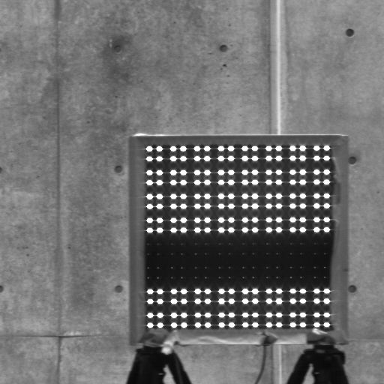
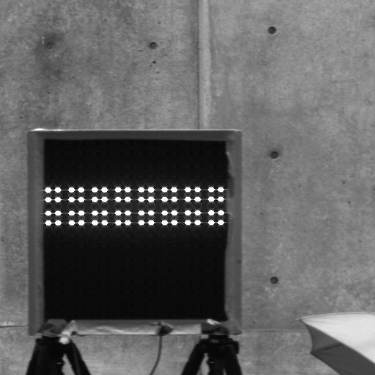
Proposed Method
Movement of LED :
Few captured images :
Correcting LED position and modified the algorithm of previous research
Using high-speed camera
Correcting
LED position
Notes:
画像は，horizontal signal 1の 372,373,374

Slide 8
Purpose of Study
We modified the acquisition algorithm using spatial and temporal gradient by implement LED position correction
We optimized the number of frames to average the spatial and temporal gradients at each pixel of the captured image
We evaluated LED acquisition success rate with horizontal and vertical LED array patterns.
Realisation of communication between a moving vehicle and a transmitter on the side

Slide 9
Contents
Reaserch background
System model of VLC and Algorithm for LED acquisition
Result of Experiment
Conclusion

Slide 10
System Model of VLC
Transmitter
Input data
On Off Keying
Modulation
LED Array
Optical
Channel
Receiver
Output data
On Off Keying
Demodulation
Image Processing
High-Speed Camera
LED Position
Estimation
LED Array
Acquisition & Tracking
The algorithm that acquisition and tracking LED array transmitter.
Calculate spatial and temporal gradient from the captured image and average these parameters over some captured images.

Slide 11
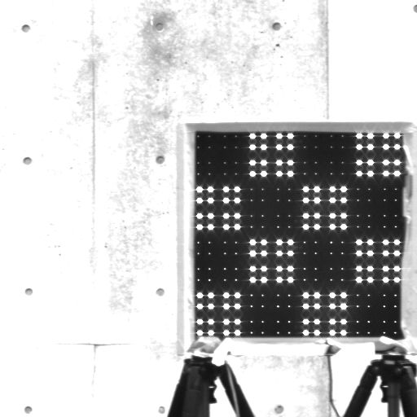
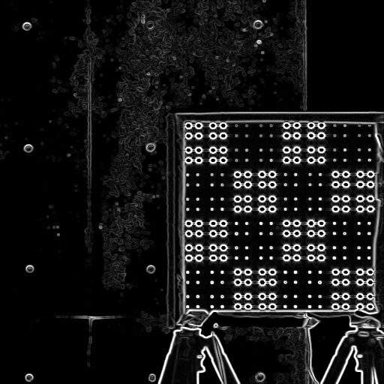
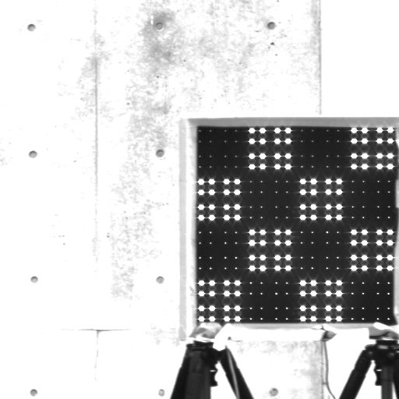
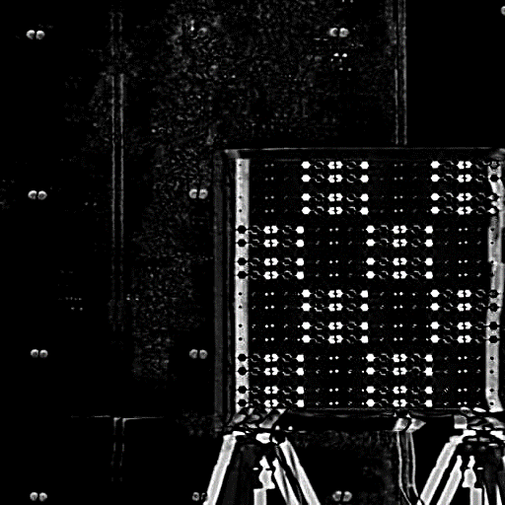
Spatial Gradient and Temporal Gradient [2]
Spatial gradient (luminance value gradient of one image)
Measure the luminance value gradient (edge) of the captured image.
Natural backgrounds with small luminance values have small values, and Objects with large luminance values (transmitters) have large values.
Temporal gradient (luminance value gradient of a series of images)
Measure the luminance value change of a series of captured images..
Since the LED array is flashing, it has a large temporal gradient.
Spatial gradient
Change luminance value
Temporal gradient
[2] S. Usui, T. Yamazato, S. Arai, T. Yendo, T. Fujii, and H.Okada, "Utilization of spatio-temporal image for LED array acquisition in road to vehicle visible light communication."
Notes:
画像は，vertical signal 1 の 536,537,538

Slide 12
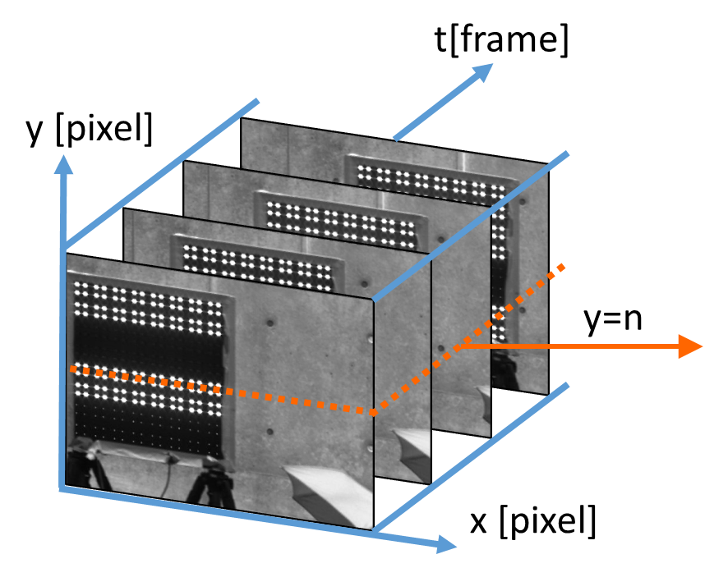

Spatial-Temporal Image and Spatial-Temporal Cross-Sectional Image
Spatial-temporal image
Three-dimensional space of images stacked in the time direction
Spatial-temporal cross-sectional image
Spatial-temporal image cut out at a certain plane
Spatial and temporal gradients can be visualized.
t [frame]
transmitter
Spatial Gradient
Temporal gradient
x [pixel]
Spatial-temporal image I(x,y,t)
Spatial-temporal cross-sectional image I(x,n,t)

Slide 13
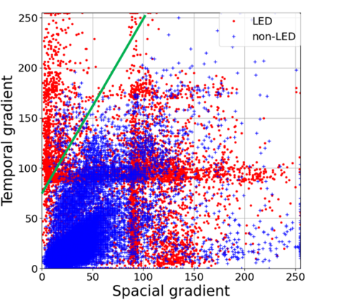

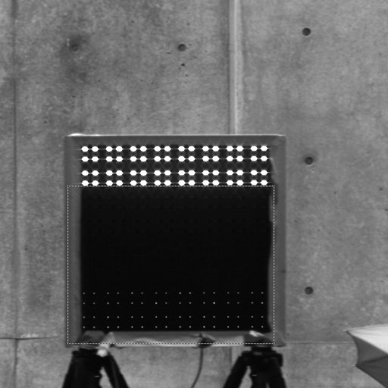
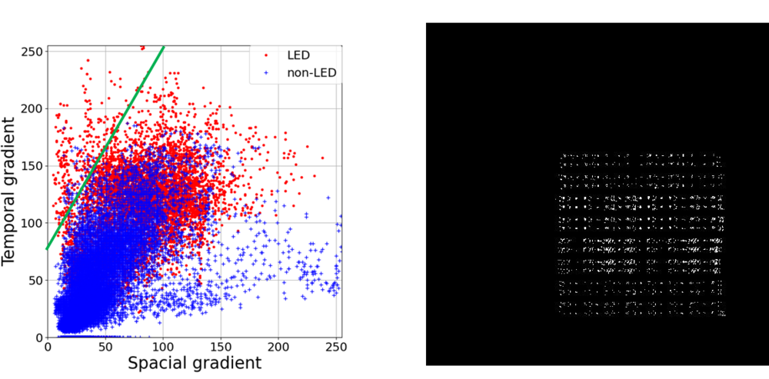
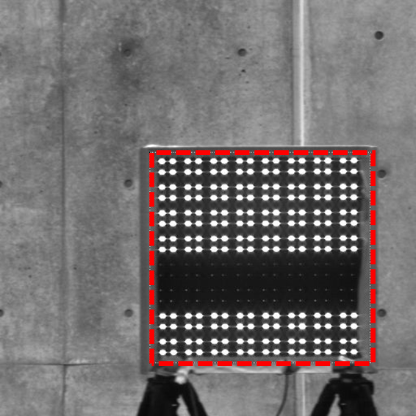
LED Acquisition and The Number of Average Frames
number of average frames
k=3
threshold detection
acquisition (failed)
number of average frames
k=10
threshold detection
Acquisition (successful)

Slide 14
Contents
Reaserch background
System model of VLC and Algorithm for LED acquisition
Result of Experiment
Conclusion

Slide 15
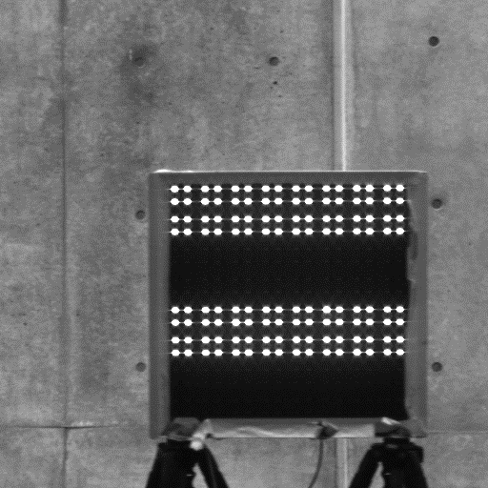
Experiment
Use LED array with 16x16 LEDs as a transmitter and a high-speed camera as a receiver
The transmitted data was OOK modulated
The transmitter LED array was divided as follows
4 divisions in 16 x 4 LEDs horizontal stripes and 4 x 16 LEDs vertical stripes
Horizontal stripes
vertical stripes
Parameters of experiment
LED blinking frequency | 500 Hz
Capturing frame rate | 1000 fps
Image resolution | 512×512 pixels
Distance from LED | 4-5 m
Vehicle speed | 10 km/h
Time・Weather | Daytime・Cloudy

Slide 16
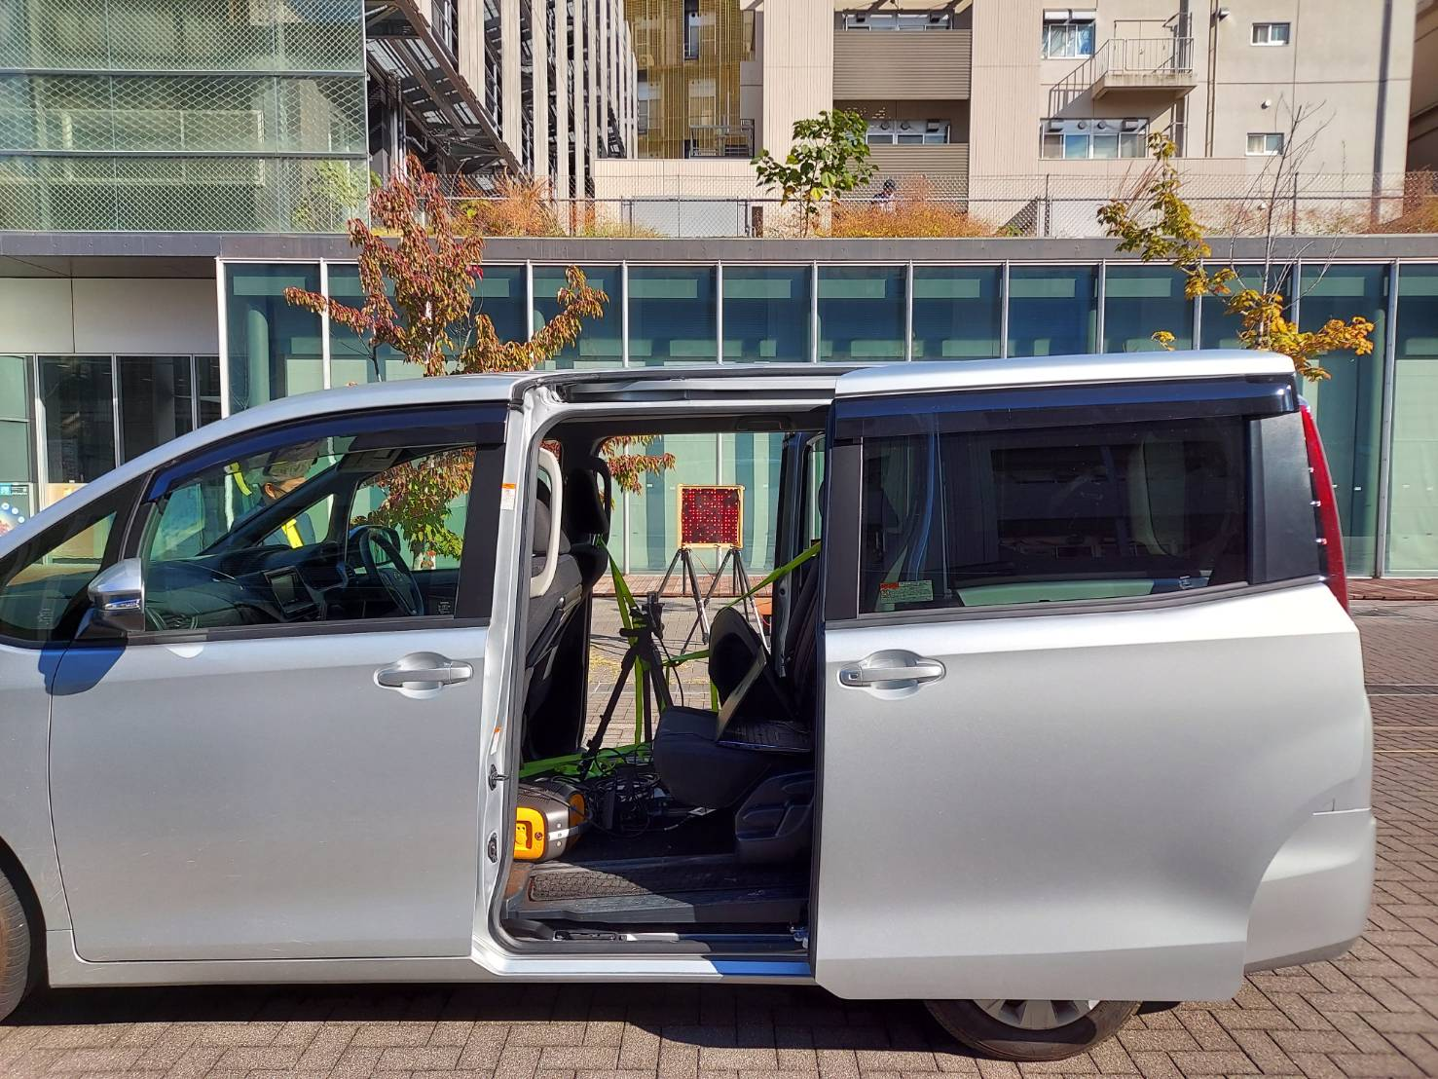
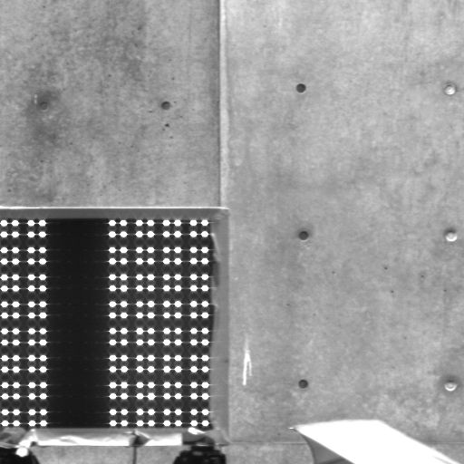
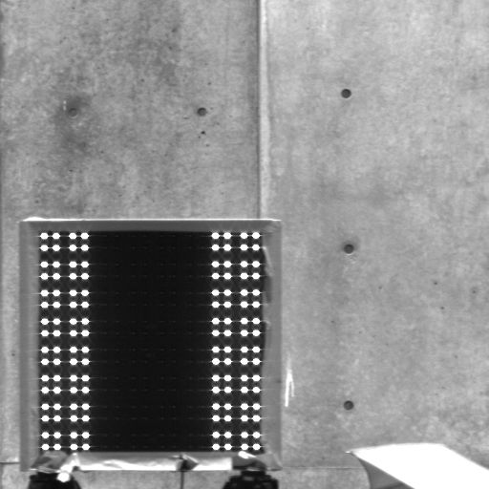
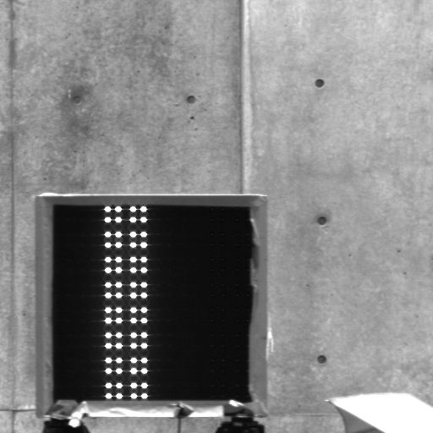
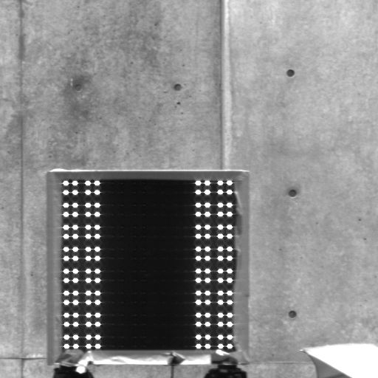
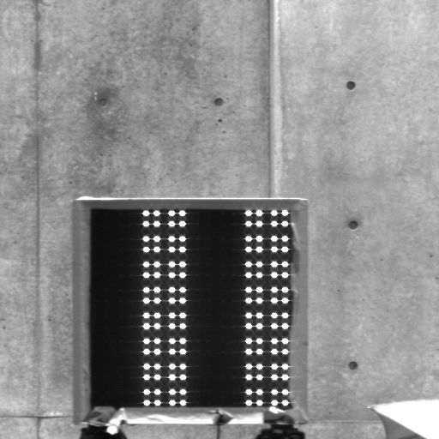
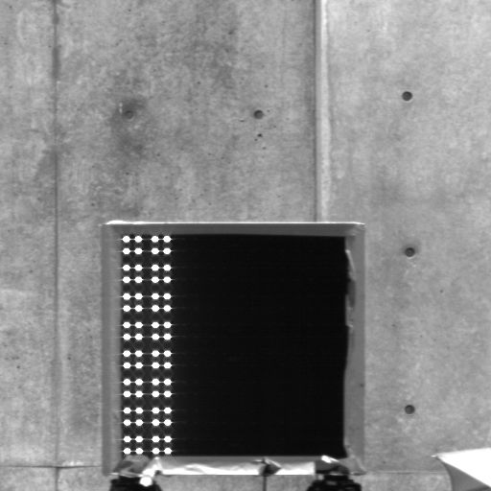
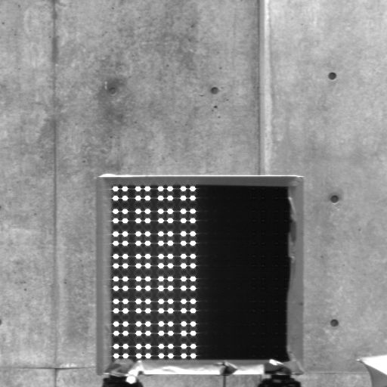
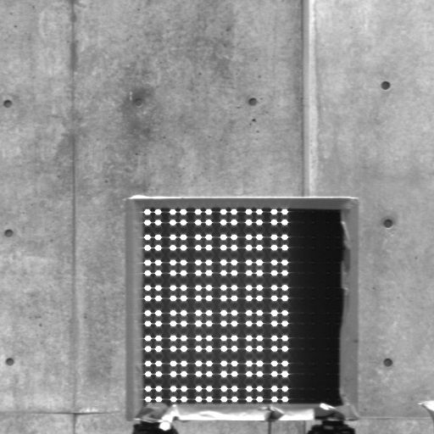
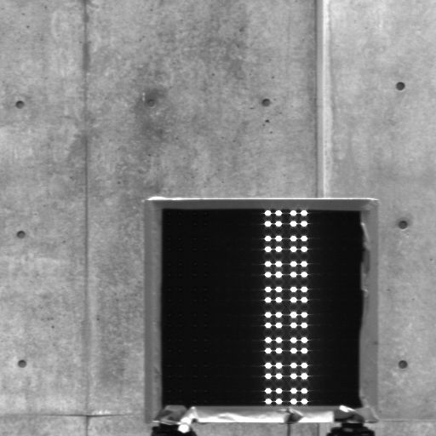
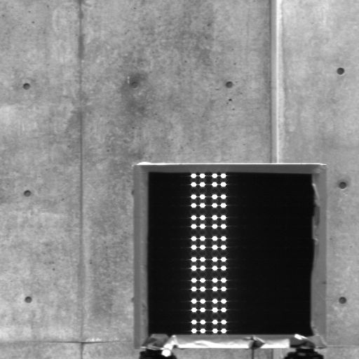
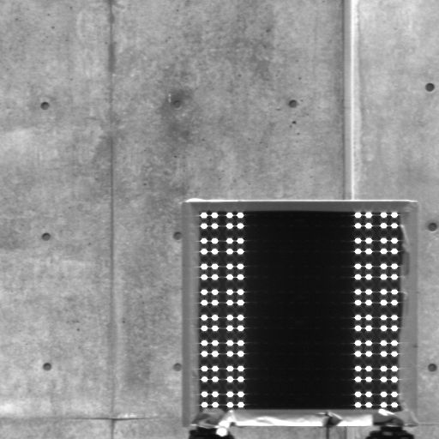
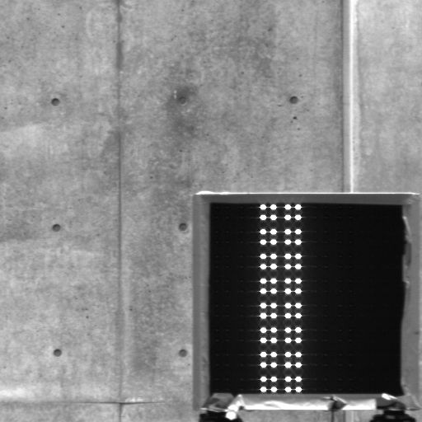
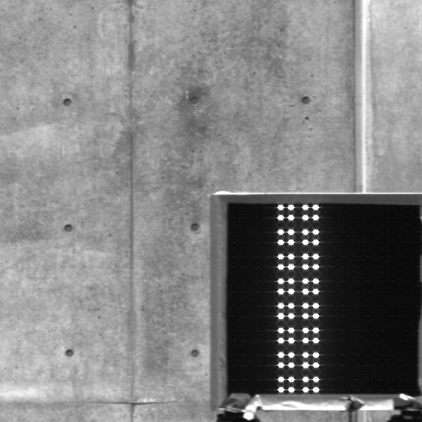
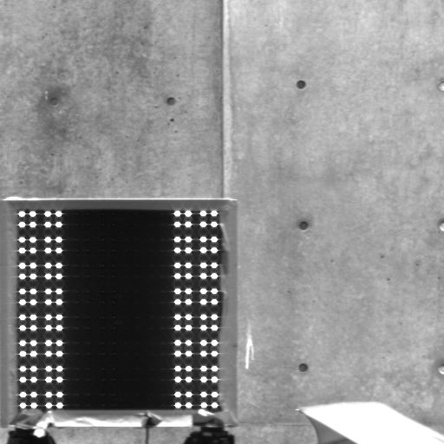
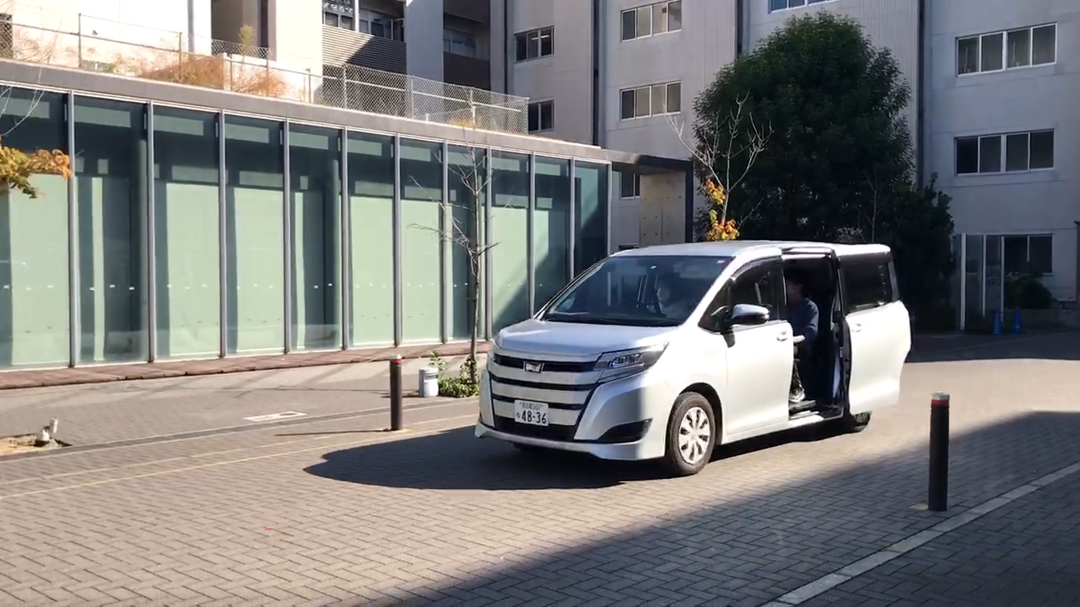
Experiment view
captured images
High-speed-camera
L E D
array

Slide 17
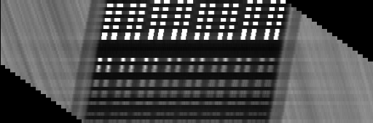
The Obtained Spatial-Temporal Cross Section Image
The corrected LED position can be see from the spatial-temporal cross section image.
t [frame]
LED array
x [pixel]
LED position
correction
t [frame]
x [pixel]

Slide 18
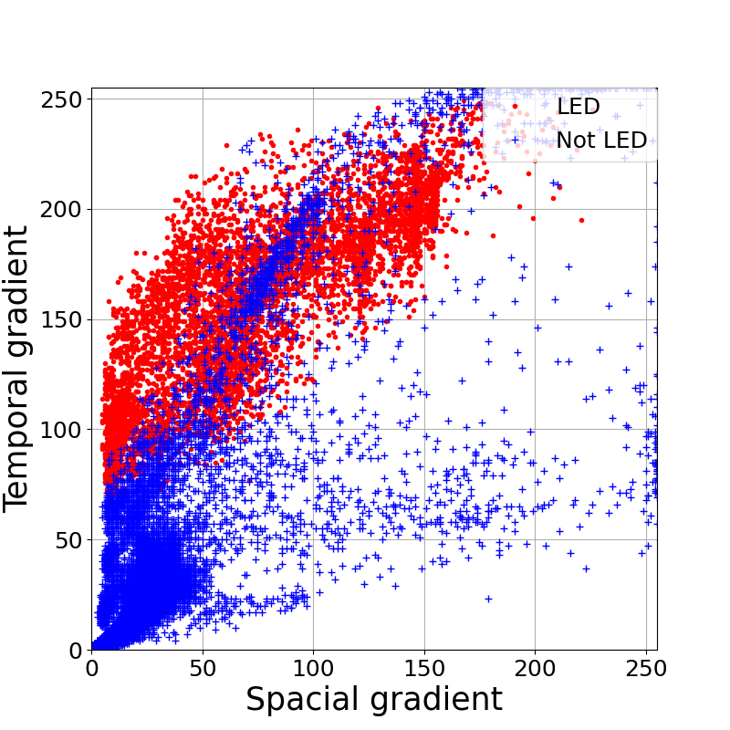
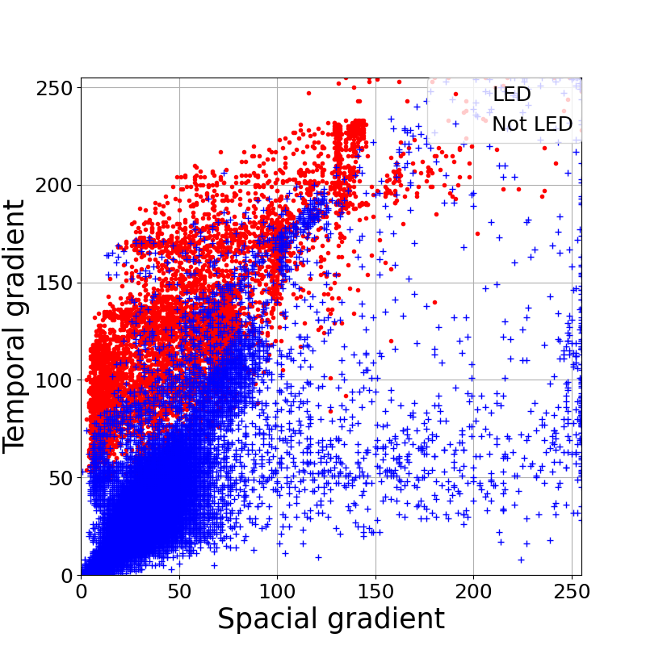
Spatial-Temporal Gradient Plots of LEDs and Backgrounds
The spatial-temporal gradients of the LED transmitter and background are calculated for each captured image, and the average value of all captured images at each pixel was calculated.
We can distinct between LED and background.
⇒We get threshold line shown in the figure below, and LED acquisition is performed.
Horizontal stripes
vertical stripes

Slide 19
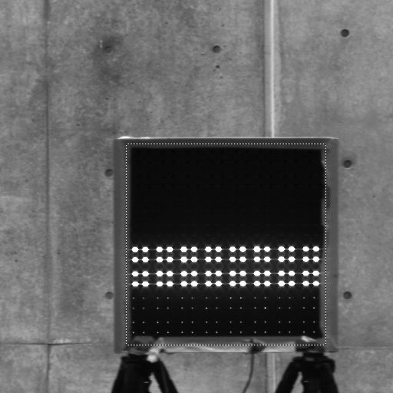
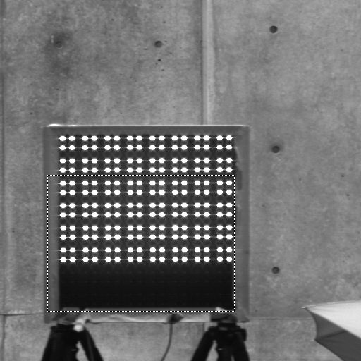
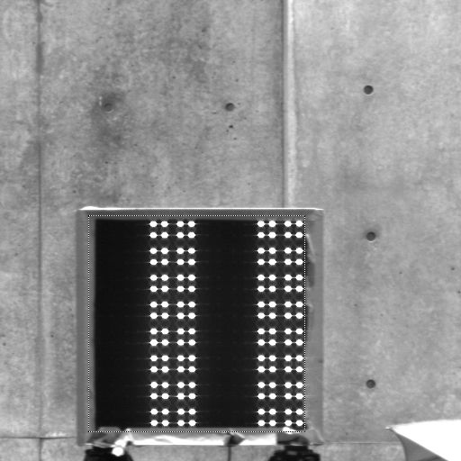
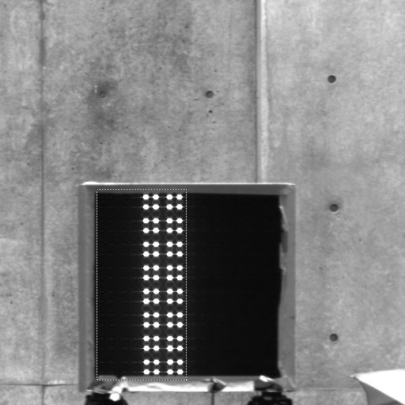
Examples of LED Acquisition Results
When acquisition failing, in a horizontal stripes, the top and bottom of the LEDs , in vertical stripes, the left and right sides of the LEDs are not acquisition respectively.
Caused by the lack of a large time gradient depending on the lighting pattern.
Horizontal stripes
Vertical stripes

Slide 20
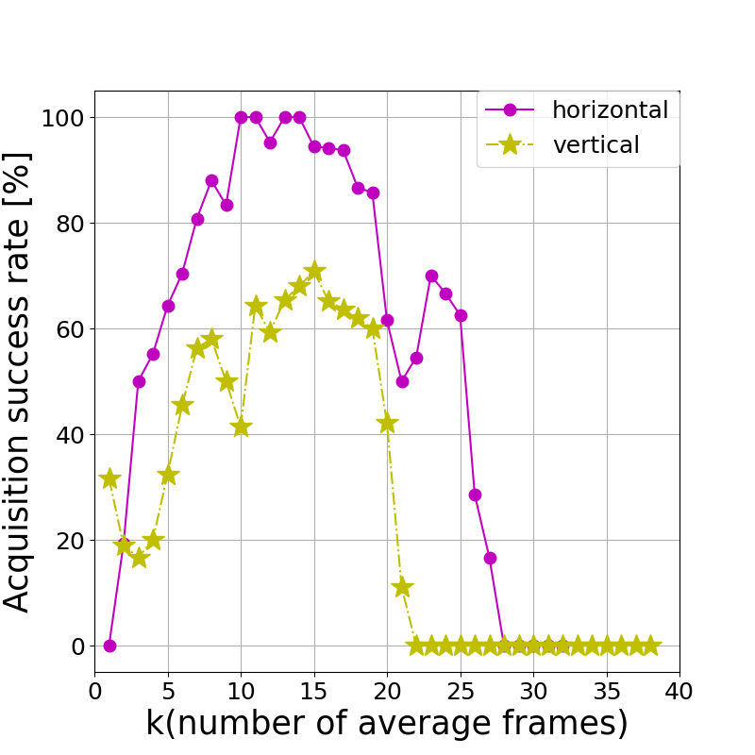
LED Acquisition Success Rate
We examined the acquisition success rate against the number of frames taking the average.
As the average number of frames increases above a certain level, the success rate tends to decrease.
Number of average frames

Slide 21
Contents
Reaserch background
System model of VLC and Algorithm for LED acquisition
Result of Experiment
Conclusion

Slide 22
Conclusion
Purpose of study
Summary
We modified the acquisition algorithm using spatial and temporal gradient by implement LED position correction
We optimized the number of average frames and when the number of average frames is 10, we achieved 100% acquisition success rate in the case of horizontal stripes patterns
We compared two LED array patterns, horizontal stripes and vertical stripes, and horizontal stripes pattern is better
Realisation of communication between a moving vehicle and a transmitter on the side

Slide 23
Supplement

Slide 24
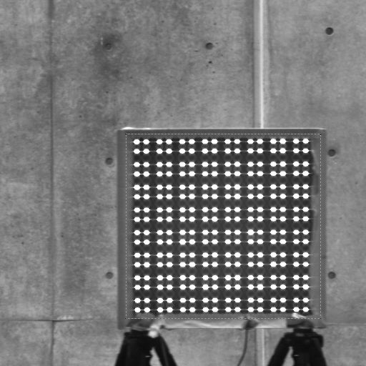
Creation of special-temporal gradient scatter plots
When making scatter plots, I used the following for LED and background respectively
LED：5x5 pixels centered on the LED after locating the LED in the image
Background: Pixels other than the above LEDs
Background
LED
Background

Slide 25
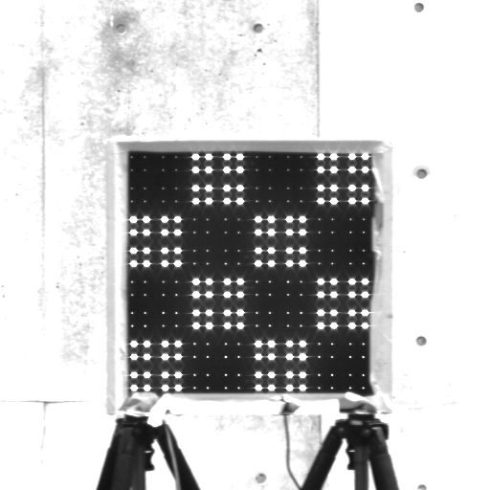
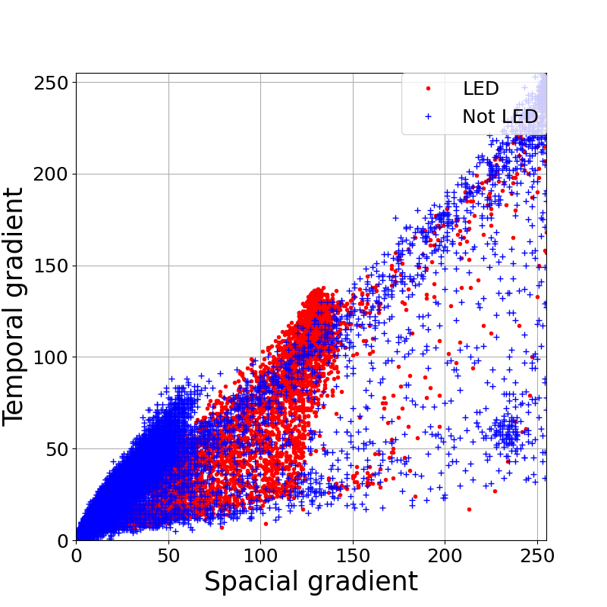
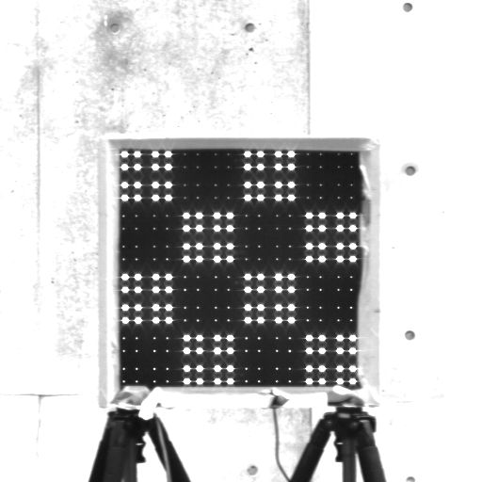
The reason why the conventional patterns could not be captured
Since the conventional patterns transmits two patterns alternately, there was no change in LED luminance, and the time gradient became small.
Conventional patterns
No luminance variation ⇒ Small time gradient

Slide 26
Future Development
Method of correcting the LED travel distance
A method of acquisition using spatial-temporal cross-sectional images without any correction. It is necessary to take the axis diagonally.
How to take into account the vehicle's travel speed
Transmit signal pattern of LED
All LEDs are used individually, not in blocks.
Because the receiver crosses the transmitter, the number of pictures taken is small (35~40 pictures).
Therefore, the LEDs are separated the data parts and the order parts.
t [frame]
LED array
x [pixel]
5 bits indicating the order
(Display the number 1- 32)
251 bits indicating data

Slide 27
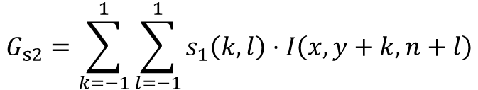
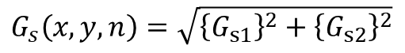
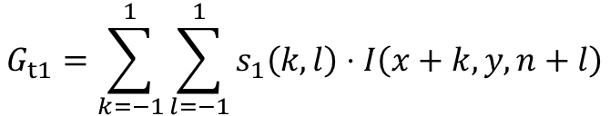
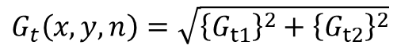
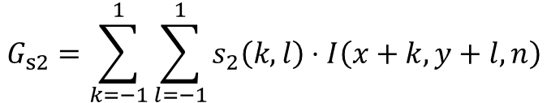
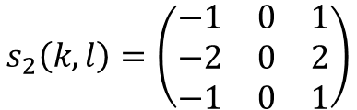


Derivation of spatial-temporal gradient
Spatial gradient
Time gradient
$$G_{s1}=\sum_{k=−1}^{1}{\sum_{l=−1}^{1}{s_{1}\left(k,l\right)}}⋅I\left(x+k,y+l,n\right)$$
$$G_{s}\left(x,y,n\right)=\sqrt{{\left\{G_{s1}\right\}}^{2}+{\left\{G_{s2}\right\}}^{2}}$$
$$G_{s2}=\sum_{k=−1}^{1}{\sum_{l=−1}^{1}{s_{2}\left(k,l\right)}}⋅I\left(x+k,y+l,n\right)$$
$$G_{t1}=\sum_{k=−1}^{1}{\sum_{l=−1}^{1}{s_{1}\left(k,l\right)}}⋅I\left(x+k,y,n+l\right)$$
$$G_{t}\left(x,y,n\right)=\sqrt{{\left\{G_{t1}\right\}}^{2}+{\left\{G_{t2}\right\}}^{2}}$$
$$G_{s2}=\sum_{k=−1}^{1}{\sum_{l=−1}^{1}{s_{1}\left(k,l\right)}}⋅I\left(x,y+k,n+l\right)$$
$$s_{1}\left(k,l\right)=\left(\begin{matrix}−1 & −2 & −1 \\ 0 & 0 & 0 \\ 1 & 2 & 1\end{matrix}\right)$$
$$s_{2}\left(k,l\right)=\left(\begin{matrix}−1 & 0 & 1 \\ −2 & 0 & 2 \\ −1 & 0 & 1\end{matrix}\right)$$
Notes:
画像は，vertical signal 1 の 536,537,538

Slide 28

Derivation of spatial-temporal gradient
Spatial gradient
Temporal gradient
Spatial gradient
Change
luminance
Temporal gradient
Notes:
画像は，vertical signal 1 の 536,537,538

Slide 29



In t=n, Derivation of spatial-temporal gradient
t=n-1
Spatial gradient
t=n
Temporal gradient
Temporal gradient
with correcting
LED position
t=n+1

Slide 30



Plots of Spatial-temporal gradient
Many points of LED and not LED overlap because Distance from LED is very close and LED array’s area include Not LED.
Cross array
Horizontal array
Vertical array

Slide 31






t
t
Spatial Gradient
y
y=n
transmitter
n
Time gradient
t [frame]
x [pixel]

Slide 32

Problem of Visible Light Communication
When demodulation in visible light communication, we should acquire LED array.
We need to identify LED and not LED
Not LED
LED array

Slide 33


Spatial-temporal cross-section image
t [frame]
LED array
A pattern
x [pixel]
t [frame]
LED array
Horizontal stripes
x [pixel]
t [frame]
LED array
Vertical stripes
x [pixel]

